Slide 1
多模態教學策略
Multimodality
分享者:王佩蘭

Slide 2
Synesthesia 共感覺、通感或聯感
Synesthesia is when your brain routes sensory information through multiple unrelated senses, causing you to experience more than one sense simultaneously. Some examples include tasting words or linking colors to numbers and letters. It’s not a medical condition, and many people find it useful to help them learn and remember information.
Oral
Audio
gestural
Written
tactile
Visual
Spatial
Multiliteracies and Learning by Design: Meaning Making and Literacy Learning in the Era
of Digital Text - Mary Kalantzis and Bill Cope

Slide 3
Synesthesia共感覺、通感或聯感
聲音
口說
Oral
Audio
肢體
文字
gestural
Written
tactile
Visual
視覺
觸覺
Spatial
空間感
Multiliteracies and Learning by Design: Meaning Making and Literacy Learning in the Era
of Digital Text - Mary Kalantzis and Bill Cope

Slide 4
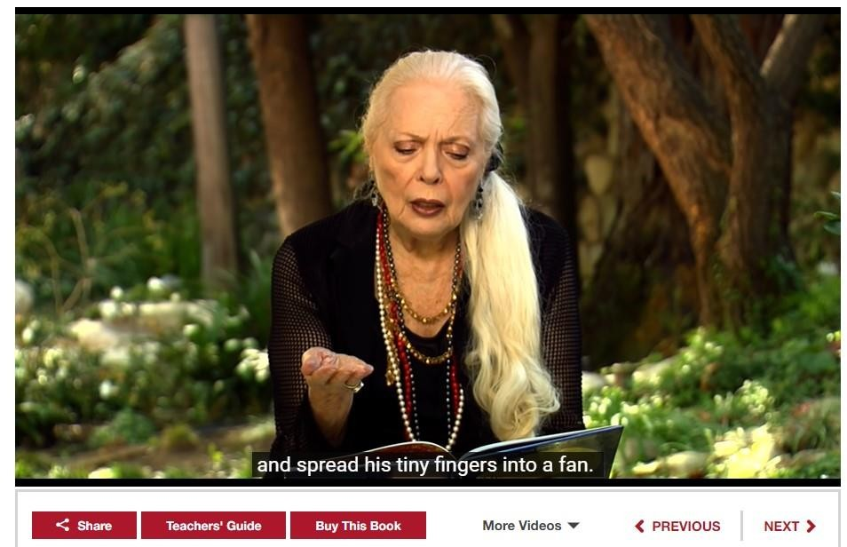
Task: How many sensory information in this story?
Mult
iliteracies and Learning by Design: Meaning Making and Literacy Learning in the Era
of Digital Text - Mary Kalantzis and Bill Cope
Story online
https://storylineonline.net/books/kissing-hand/

Slide 5
Meaning Making for Communication
Written Mode
Image Mode
The logic of display in space spatial and non sequential
The logic of succession in time temporal and sequential
Multiliteracies and Learning by Design: Meaning Making and Literacy Learning in the Era
of Digital Text - Mary Kalantzis and Bill Cope

Slide 6
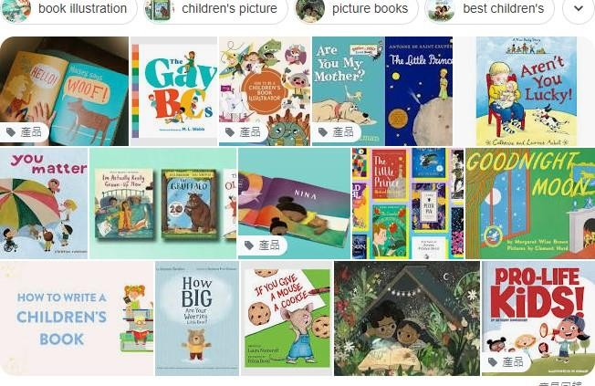
Let’s see the children book
Multiliteracies and Learning by Design: Meaning Making and Literacy Learning in the Era
of Digital Text - Mary Kalantzis and Bill Cope

Slide 7
Let’s see the children book
Written mode
Visual mode
Audio mode
Multiliteracies and Learning by Design: Meaning Making and Literacy Learning in the Era
of Digital Text - Mary Kalantzis and Bill Cope

Slide 8
Task: How many modes in this story?
Why Multimodality?
Help to reinforce
knowledge, understanding and learning.
The more ways the same information is delivered.
The stronger the memory will likely be.

Slide 9
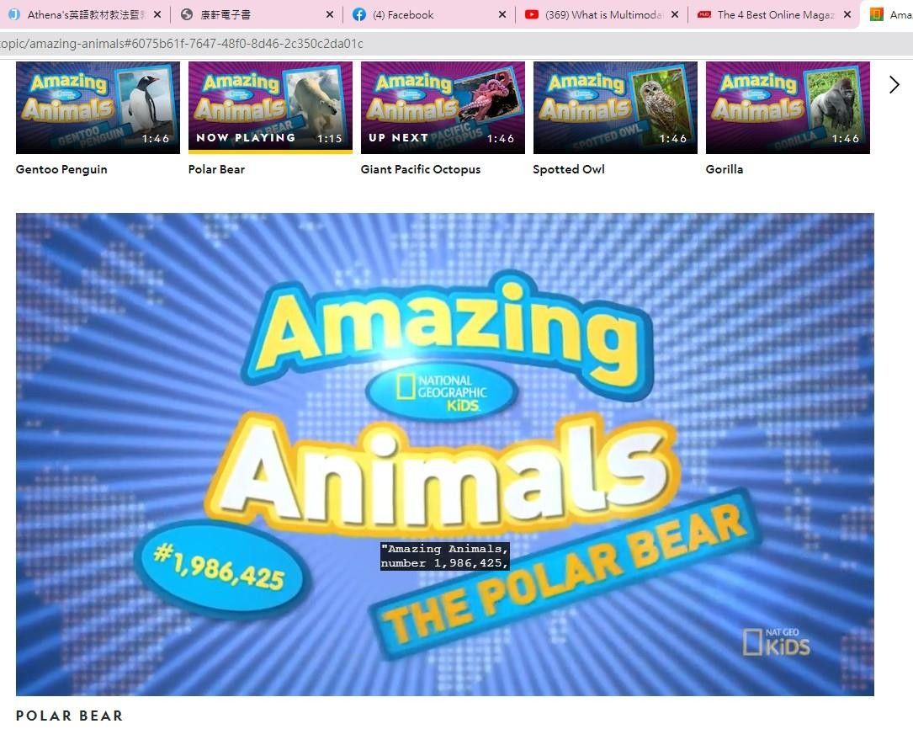
Task: How many modes in this movie?
https://kids.nationalgeographic.com/videos/topic/amazing-animals#6075b61f-7647-48f0-
8d46-2c350c2da01c

Slide 10
How can you use multimodal components in your bilingual class?
A video to introduce your content
Enhance your course by adding links, images, sound and videos.
Multiliteracies and Learning by Design: Meaning Making and Literacy Learning in the Era
of Digital Text - Mary Kalantzis and Bill Cope

Slide 11
The language used in an English language classroom as part of the main content which students must learn
Target Language
English skills, subject knowledge and content.

Slide 12
Thinking Task
How can I use
multimodality strategy during my bilingual teaching?

Slide 13
Thinking Task
Step 1
Confirm the teaching goal What do you teach?

Slide 14
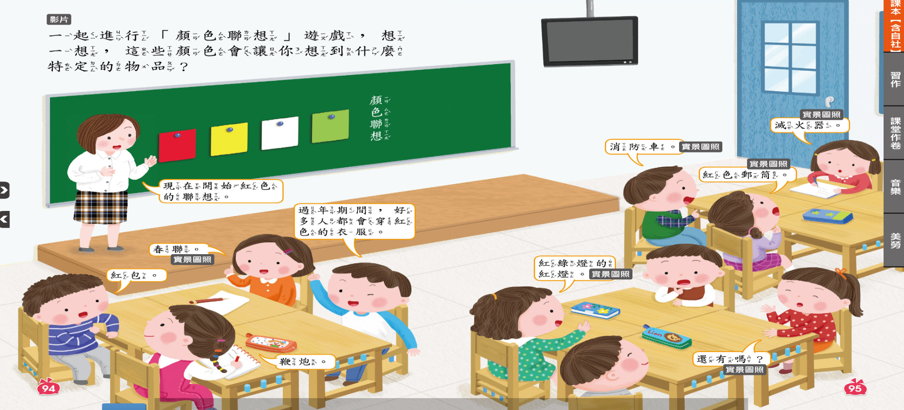
Colors connect with the things in life

Slide 15
Thinking Task
Step 2
How to communicate
all the new ideas or knowledges In different modes ?

Slide 16
Use different modes to express the ideas and give examples.
for teachers and students

Slide 17
Thinking Task
Step 3
Surf the teaching materials which can convey the meaning ?

Slide 18
Thinking Task
Step 4
Arrange the teaching process and learning experience

Slide 19
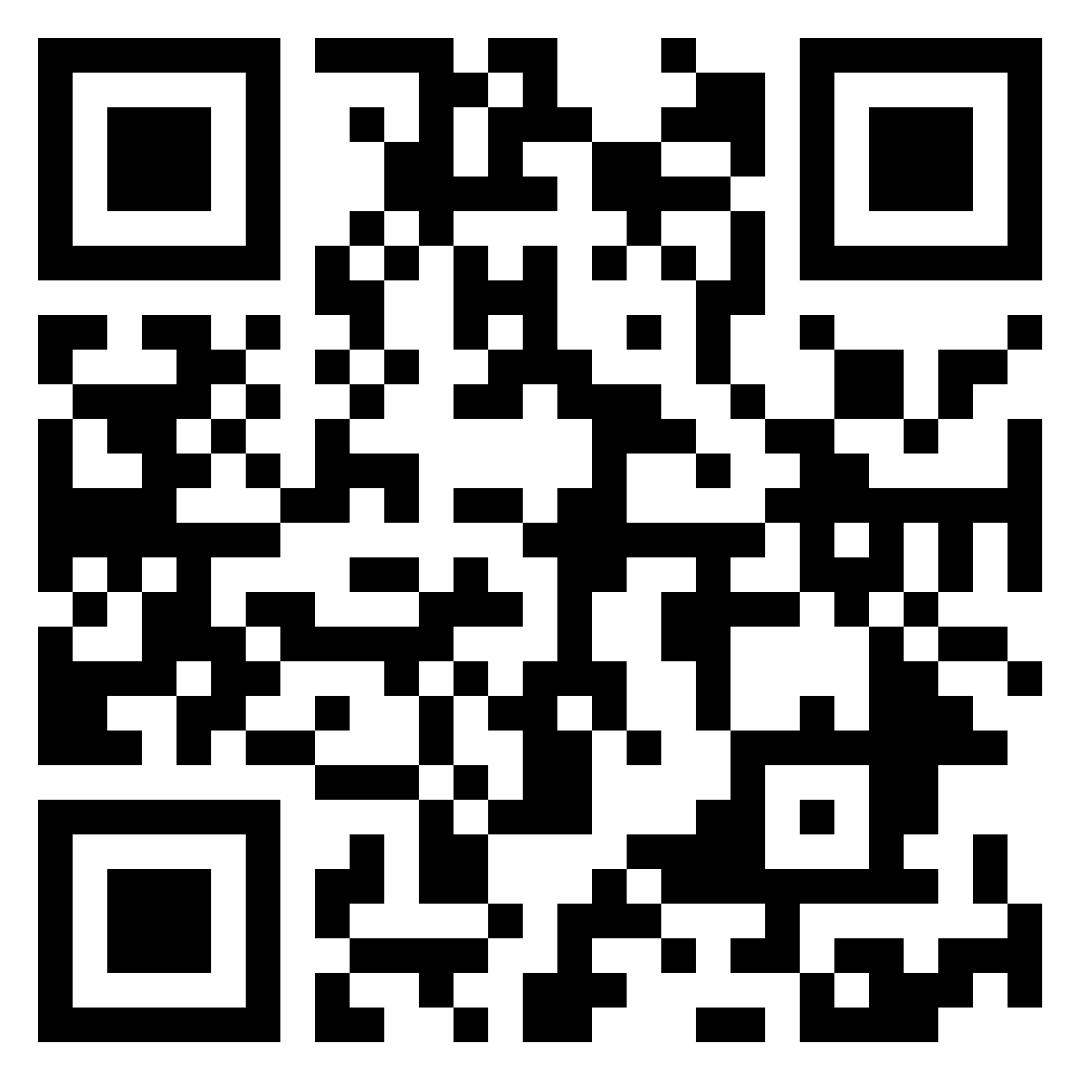
Make a PPT to show the teaching and learning processes with multimodality strategy.
And up load to the link or scan the Qr code.
https://padlet.com/fr202516/ppt-with-multimodality-strategy-v9cltbiydchnwbbr

